Slide 1

BeSafe: IoT Based Safety Band
Group No. 12
Ganesh Jambuka 18104044
Krishi Shah 19104009
Riddhi Shah 19204010
Guided by
Prof. Anagha Aher
Notes:
‹#›

Slide 2
Contents
Introduction
Objectives
Problem Definition
Technological Stack
Review Suggestions (Given in Last meeting)
Proposed System Architecture/Working
Prototype Design Demonstration
Implementation Status
Status of Paper Draft & Targeted Conference
Notes:
‹#›

Slide 3
Introduction
Women Safety in India is widely discussed everywhere nowadays. It has now become a major issue, The crime rate is on the spike.
Considering the situation, we have designed a system through which a woman will be able to receive administrative assistance in a very short time.
We used a band as hardware and a mobile application as software, Hardware and software are connected to each other via Bluetooth.
Our system helps the women when are involved in sexual harassment and is also made to help the victim when they come across an accident or any other crisis by tracking and sending their real time location to the police via SMS using GSM module and GPS module when the user not online.
Our system helps them to store the coordinates of the place where the push button was pressed. All the data will be saved on firebase and will do data analysis and report it to police/government officials.

Slide 4
Objectives
To achieve the location of the victim we will be using the GPS and GSM module which will help their family to locate them.
To send SMS’s free of cost we will use the SMS gateway API.
To achieve the current location it will be converted into a Google Map URL link and send through cross platform application to the concerned one.
To analyse the data/logs received from all the users so that it can be further used by police to identify the areas where emergencies had occurred with the help of bluetooth module which will send the data to the application and stored into the firebase.

Slide 5
Problem Definition
Problem Identified:
The free movement of women are being hampered by sexual abuse. In the present world, sexual harassment is one of the major obstacles to women’s empowerment.
The person who is in unmovable situation due to an accident or alone who needs help.
Solution Proposed:
We proposed to make an app that helps the women to reach her family with single a click whenever she is in trouble.
We are also planning to create a system so, whenever a person meets with an accident can contact the concerned authority by a single click hereby sending his/her location to the police.

Slide 6
Technological Stack
Hardware:
Arduino nano: approx. 300/- rupees
GSM/GPRS/Bluetooth 2g module : approx. 1900/- rupees
Push Button : 70/-rupees
Software:
Firebase
Flutter
Android studio
Xcode
Arduino IDE

Slide 7
Review Suggestions
Verification if the button pressed(if the button is pressed twice then only the message will be send)
SMS gateway(by using SMS gateway API we can send SMS free of cost)
Data analytics through data received at admin side(The data which is stored on Firebase will be converted into csv file after that we will do data analysis on the same data)
Government aspect(after converting it to a csv file we will pass it on to the government officials so that they can improve the security if needed)
Cross platforming(we are creating the platform independent application by using Flutter)

Slide 8
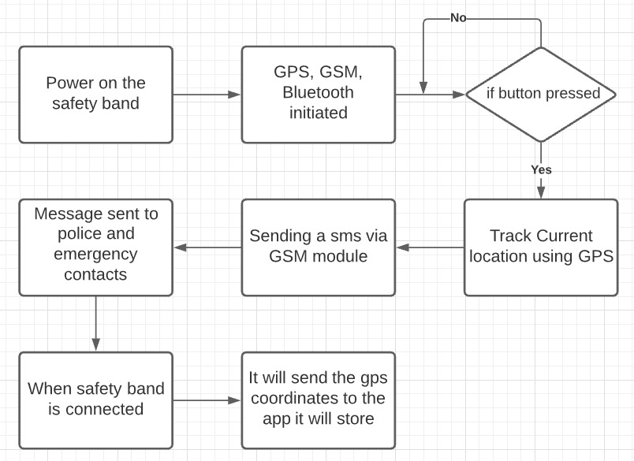
Proposed System Architecture/Working
Block Diagram for Safety Band:

Slide 9
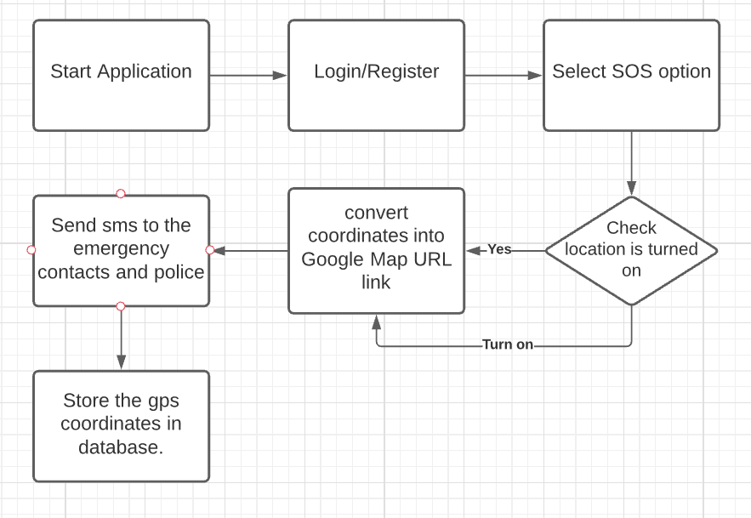
Block Diagram for App:

Slide 10
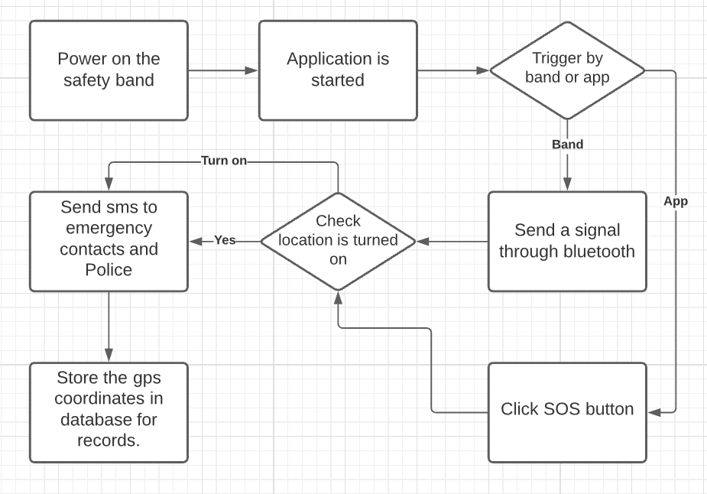
Block Diagram for Safety Band and App:

Slide 11
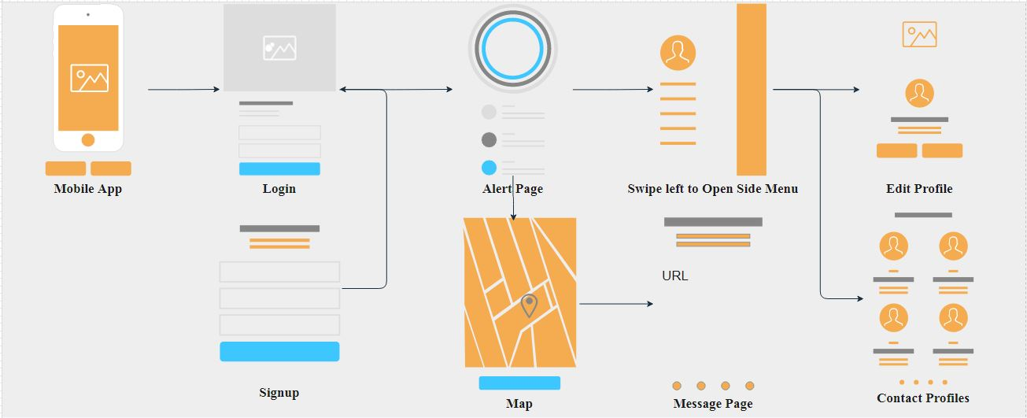
Prototype Design Demonstration
Fig 1:App Flow

Slide 12
Implementation Status
Started implementing a cross-platform application using flutter.
The frontend (UI) part is almost completed left with a few pages, like Profile Page to store the information of the end-user for data analysis.
The application can send multiple messages to the contacts which will be provided by the end-user.
It can be able to send a google map URL link via SMS.
And other features were also implemented suggested by teachers and project guide.
Started working on data analysis and SMS gateway API.

Slide 13
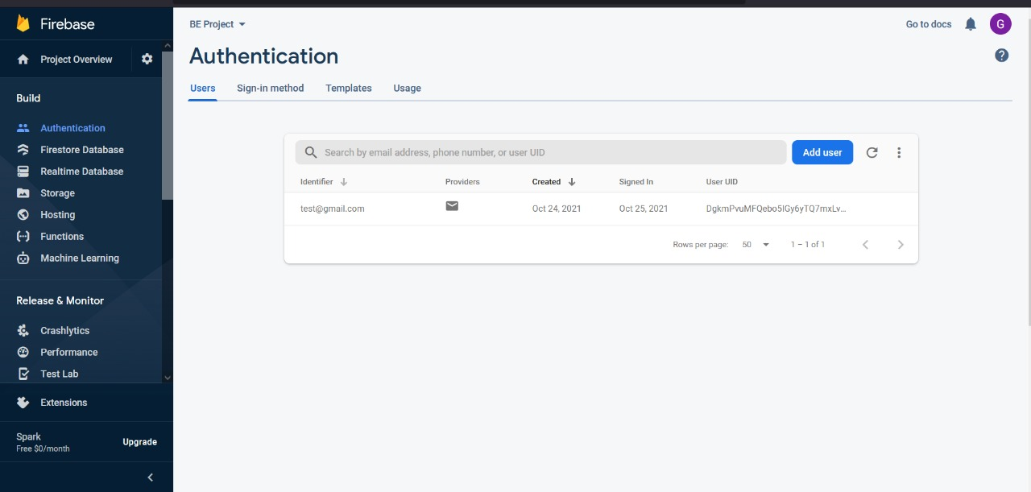
8. Implementation
Fig 2: Firebase Authentication Page

Slide 14
App Implementation
After successful registration, the user will log in to the Application, then he will have different options to choose from i.e SOS, Nearby locations, Speed dial. If the user needs urgent help, he/she must press the SOS button then it will send the current location i.e google maps URL link as SMS to the respective contacts which were added by the user on the contacts page. If he/she wants to know the Nearby Hospitals, Police stations, or Public places they can simply press the buttons to get to the respective locations. The Speed Dial button offers various features like Emergency calls, Location, and Contacts. If he/she needs emergency help they can use the emergency call button which will call the respective person. If the user wishes to add, delete or modify the contacts, the user must press the contact button which will redirect him/her to the contact page.

Slide 15
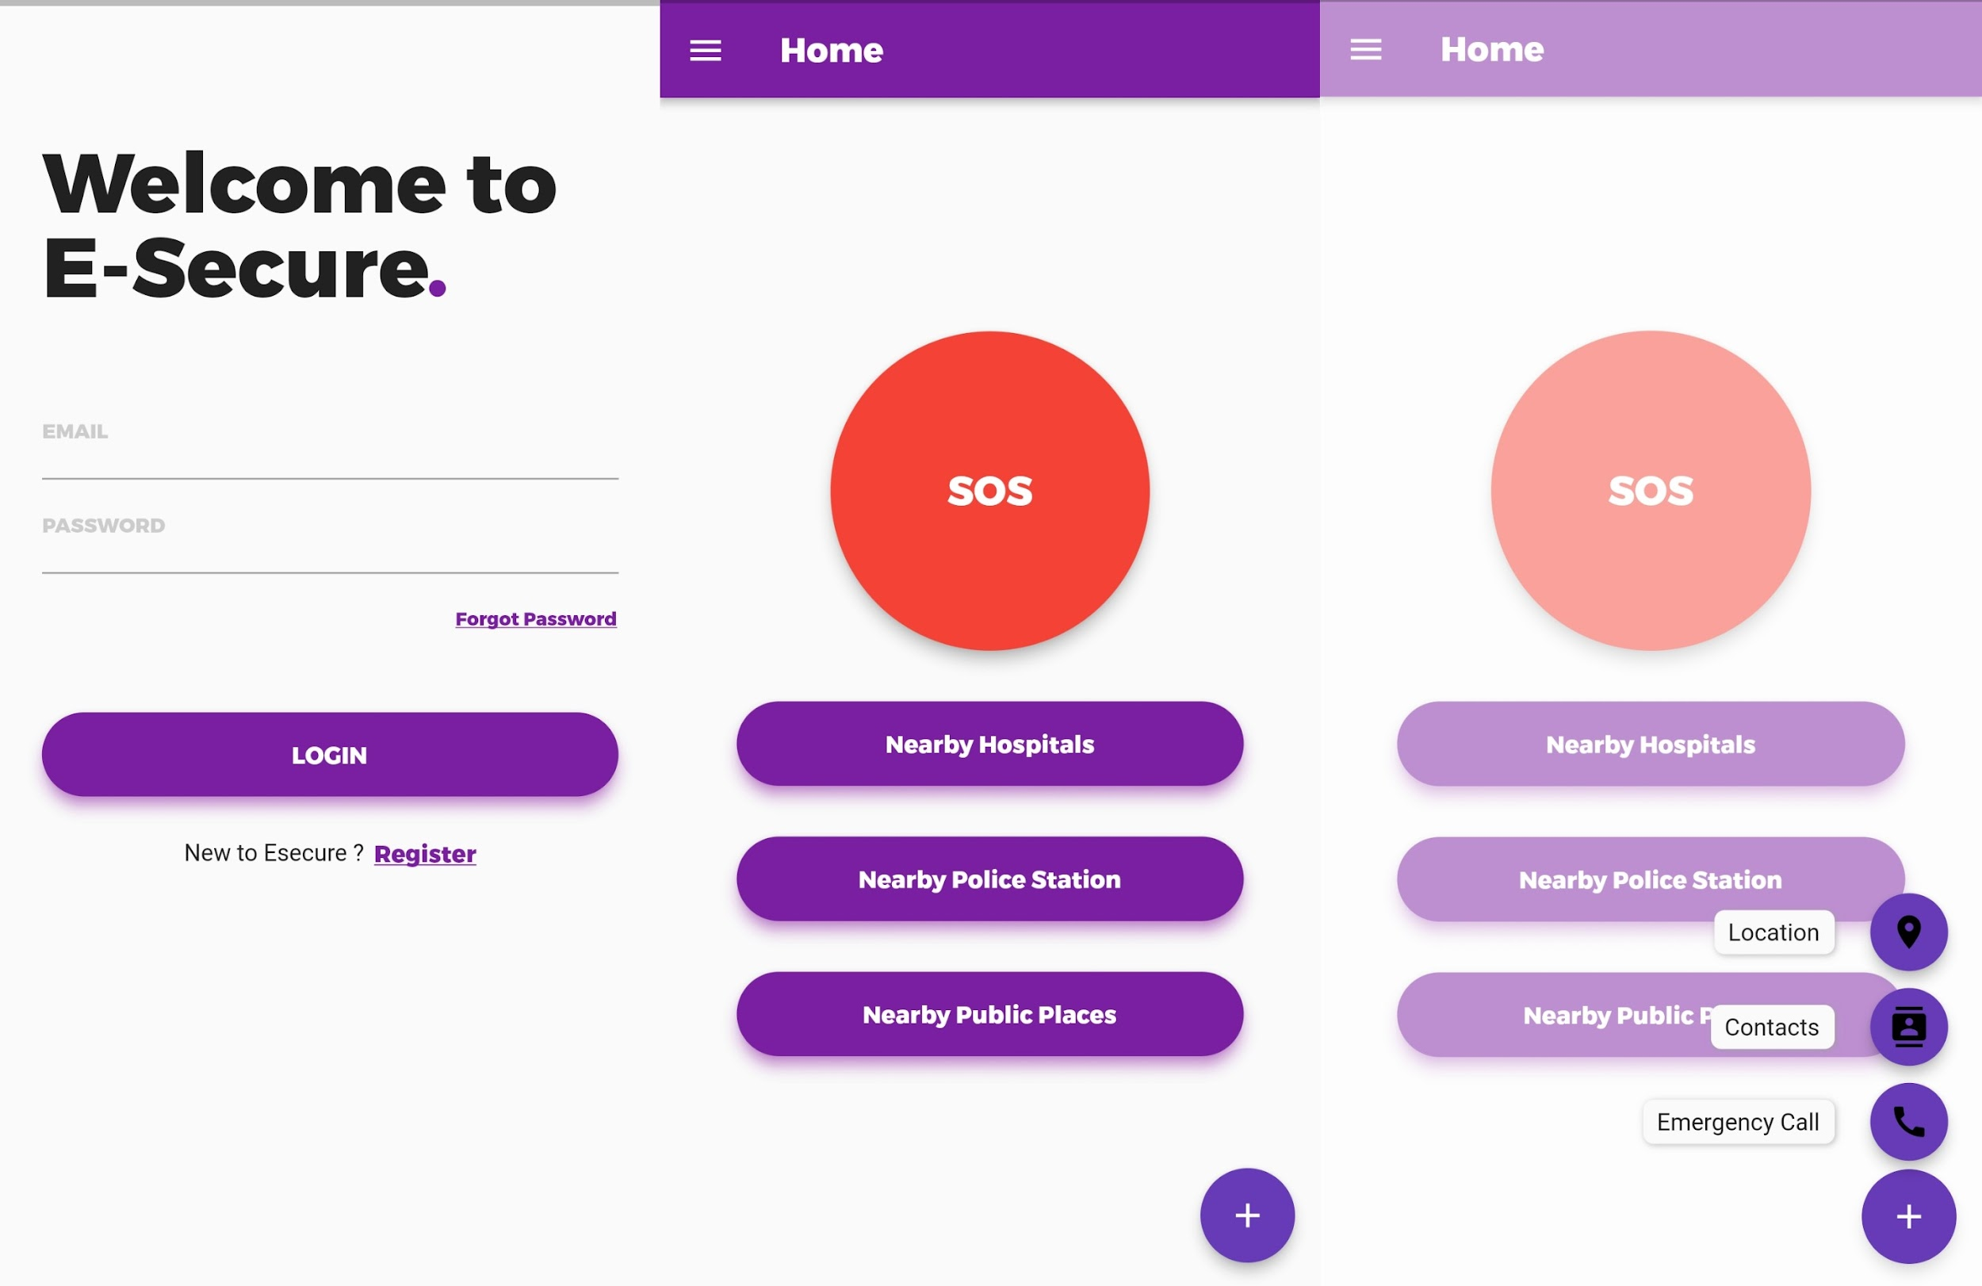
Fig 3: App UI

Slide 16
Status of Paper Draft & Targeted Conference
ICICV 2022 : 4th International Conference on Intelligent Communication Technologies and Virtual Mobile Networks
Submission Deadline Tuesday 20 Nov 2021
Conference Dates Feb 10, 2022 - Feb 11, 2022
http://icicv.org/2022/
2nd International Conference on Pervasive Computing and Social Networking (ICPCSN 2022).
Submission Deadline Tuesday 20 Nov 2021
Conference Dates 3-4, March 2022
http://icpcsi.in/2022/
IEEE International Conference on Computing, Communication & Internet of Things Sri Sai Ram Engineering College Chennai, India, March 10-11, 2022
Abstract registration deadline December 1, 2021
Submission deadline December 20, 2021
https://www.ieeeic3iot2022.org/ic3iot-2022

Slide 17
Thank You...!!
Notes:
‹#›

